Slide 1
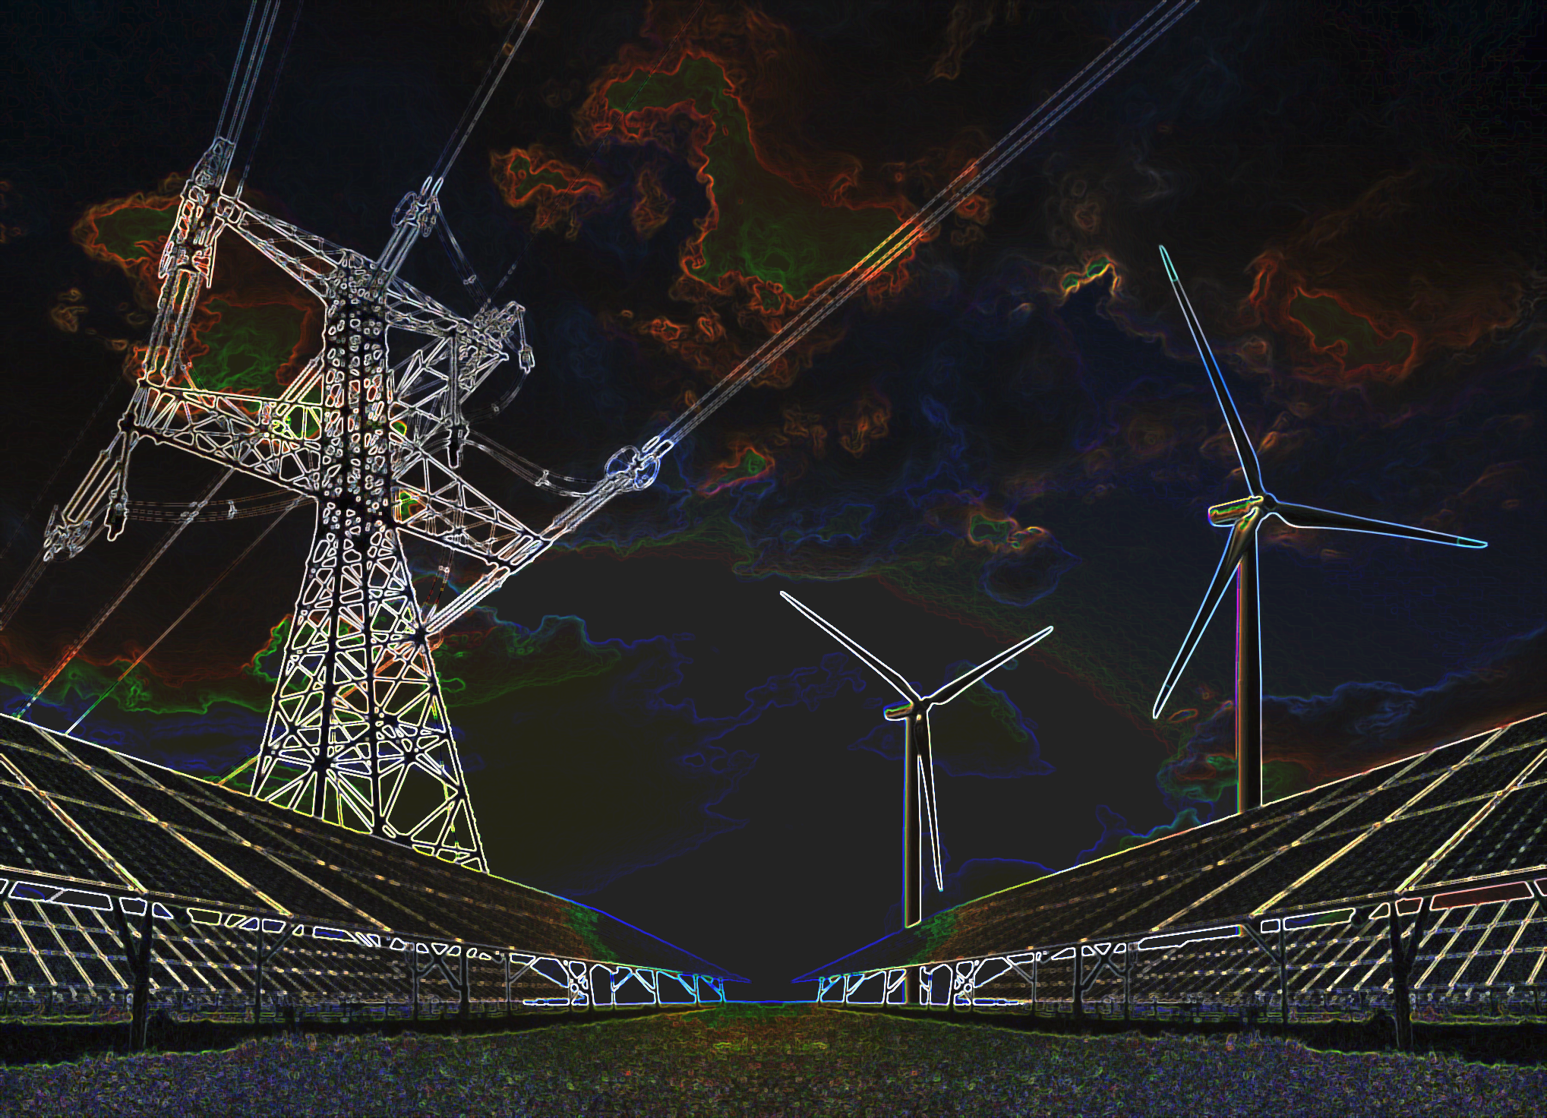
Modeling the power flow for the substation of a wind-and solar farm
M.Mastouri, 4599470
F.N.Rimon, 4652827
01/07/2020

Slide 2
Outlines
Project objective
Research questions
Requirements
Model of the system
Cable and components modeling
WTG modeling
PV design & modeling
Test models
Operating conditions
Results
Conclusions

Slide 3
Requirements
Research questions:
How are the system components modeled correctly?
What is the relation held between voltage magnitudes, power losses and load demands in the system?
What are the effects on the aforementioned parameters and mutual relation for a variation in dispatch profiles?
What are the effects on the aforementioned parameters and mutual relation for a change in the system topology?
What are the effects on the aforementioned parameters and mutual relation for an improved model of the system configuration?
Main requirements:
1. Update parameters
2. Indicate physical violations
3. Calculate losses
4. Calculate power generation due to fluctuation in dispatch profiles

Slide 4
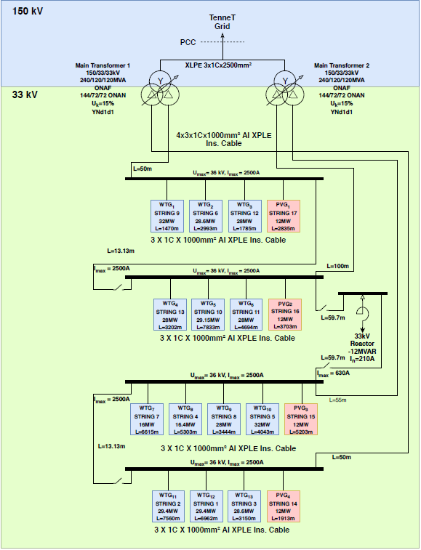
Model of the system
System topology
Modeling tool: MatPower
Notes:
Firstly, an overview of the case study is made, in which the connection of the different components and devices is shown. Afterwards, this case study is implemented using matpower. The active power generation of the wind turbine strings was given, but the active power generation of the pv strings had to be determined taking into account the power limits of the weak components. The weak components are considered to be the components which have the lowest power limits.

Slide 5
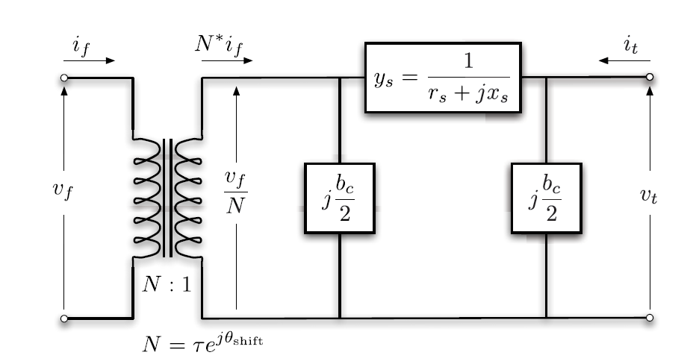
Cable & Transformer modeling
Cable π-model
Cable data
3x1Cx2500 mm2 Al XLPE
3x1Cx1000 mm2 Al XLPE
1x800 mm2 AAC Conductor
Transformer data
Losses
Voltage tap positions
Notes:
-Branch calculations made to p.u.
Three different cables are used in this case study. The cables are modeled using the cable pi-model. With the datasheets of the cables, the real impedances and reactances are determined and afterwards converted into p.u values using the base impedance. Furthermore, the transformer losses are modeled using the leakage reactance. For this transformers, this value was 15%. From the literature study, it was concluded that this is a good approximation. Eventually, the voltage tap position range is determined considering the min and max voltages at the low and high voltage side.
Process from real, using base to p.u.

Slide 6
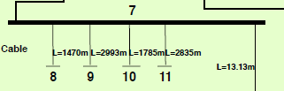
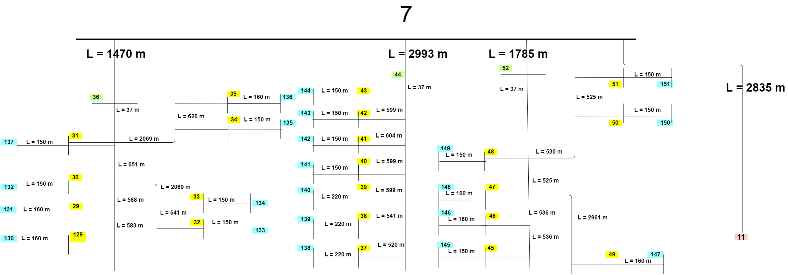
WTG modeling
Aggregated model
String level model
91 WTGs
Spread over 4 main bus bars
Notes:
Firstly, an overview of the case study is made, in which the connection of the different components and devices is shown. Afterwards, this case study is implemented using matpower. The active power generation of the wind turbine strings was given, but the active power generation of the pv strings had to be determined taking into account the power limits of the weak components. The weak components are considered to be the components which have the lowest power limits.

Slide 7
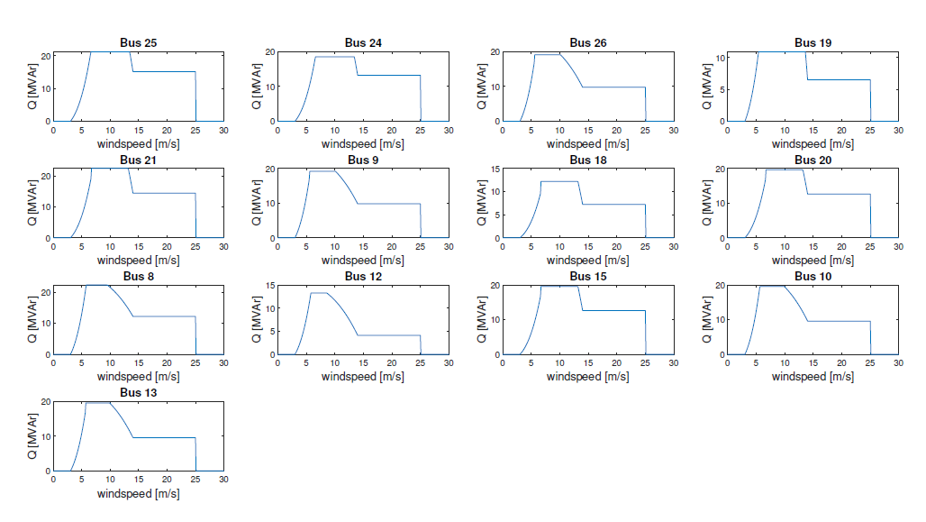
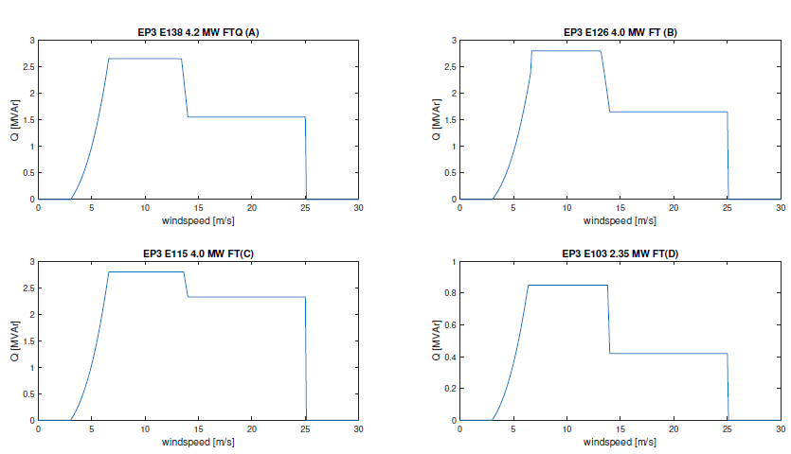
WTG modeling
Capablity curves
Aggregated model String level model
Notes:
Firstly, an overview of the case study is made, in which the connection of the different components and devices is shown. Afterwards, this case study is implemented using matpower. The active power generation of the wind turbine strings was given, but the active power generation of the pv strings had to be determined taking into account the power limits of the weak components. The weak components are considered to be the components which have the lowest power limits.

Slide 8
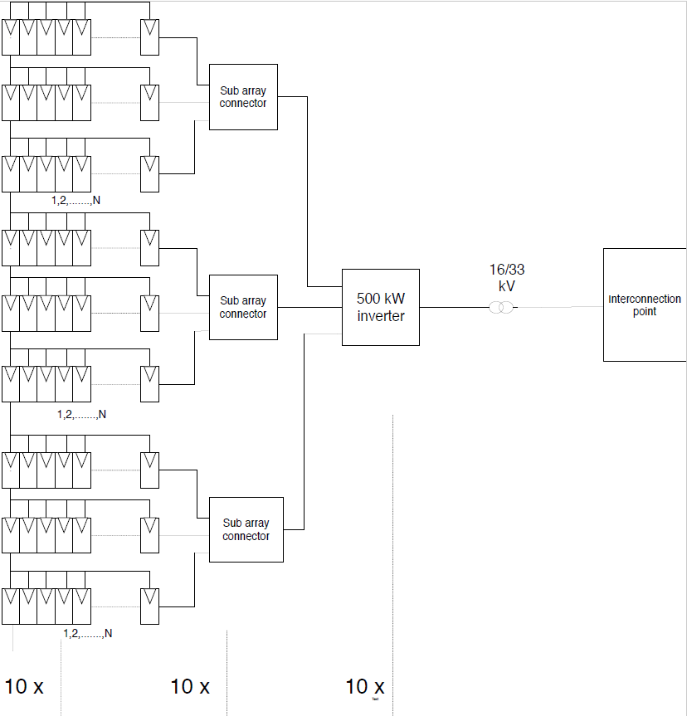
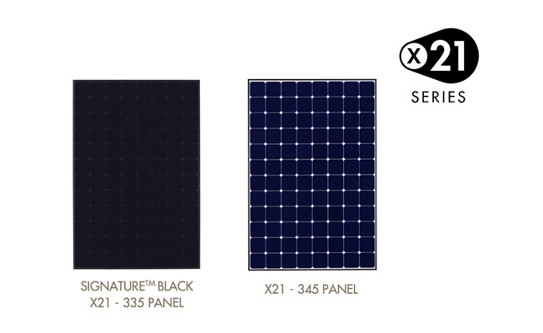
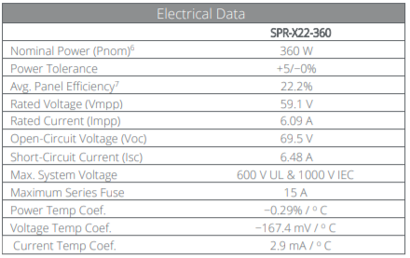
Solar Farm design
Topology power limits
Configuration
Sunpower X-series solar modules
Notes:
With this information the solar farm is designed as shown in the figure. In order to satisfy the generation of 12 MW, this section has to be implemented 10 times in one PV string. The number N is equal to 264 and each array is implemented 266 times. In order to connect the high amount of arrays sub array connectors are implemented. The solar modules used are Sunpower X-series, which are also shown in the figure. This modules are chosen, because of their high efficiency and the availability of the data.

Slide 9
Operating conditions
Random load demands and fixed WTG P-Q output
Random load demands and fixed PV P-Q output
Random load demands and fixed WTG and PV P-Q outputs
Random load demands and random PV P-Q output​
Notes:
Different operating conditions are tested to determine the behaviour of the transmission system.
For a correct analysis of the effect of individual components on the system behaviour, for each of the case models, it is assumed that the uncorresponding Renewable Energy Source is disconnected from the transmission system. In the first case, the PV module is disconnected to test the interaction between a daily wind profile and random load demands. The second case, disconnects the WTG and tests a daily solar profile and random load demands. Every new case, will involve more extreme conditions to test for both Renewable Energy Sources. This makes it possible to determine the system behaviour for each possible weather condition and demand, in a stepwise manner.

Slide 10
Operating conditions
Farm behavior analysis | Wind speed (m/s) | Solar irradiance (W/m2)
Wind farm | 4 - 7.5 - 14 | -
Wind farm: shunt connected | 4 - 7.5 - 14 | -
Wind farm: string level | 7.5 | -
Solar farm | - | 100 - 500 - 800
Hybrid farm | 4 - 7.5 - 14 | 100 - 500 - 800
Notes:
Different operating conditions are tested to determine the behaviour of the transmission system.
For a correct analysis of the effect of individual components on the system behaviour, for each of the case models, it is assumed that the uncorresponding Renewable Energy Source is disconnected from the transmission system. In the first case, the PV module is disconnected to test the interaction between a daily wind profile and random load demands. The second case, disconnects the WTG and tests a daily solar profile and random load demands. Every new case, will involve more extreme conditions to test for both Renewable Energy Sources. This makes it possible to determine the system behaviour for each possible weather condition and demand, in a stepwise manner.

Slide 11
Results
Notes:
The first steps were completed in order to assure deliverables are satisfied. The group was able to process and implement the necessary data to design an initial model that converges. Next, the rated output of Wind Turbine Generators was assumed and random load demands were requested for a day. Here plots are seen of the outputs of each power flow. The same was done for the solar farm, that produces 36 MW divided in four strings.

Slide 12
Conclusions
Notes:
The first steps were completed in order to assure deliverables are satisfied. The group was able to process and implement the necessary data to design an initial model that converges. Next, the rated output of Wind Turbine Generators was assumed and random load demands were requested for a day. Here plots are seen of the outputs of each power flow. The same was done for the solar farm, that produces 36 MW divided in four strings.

Slide 13


Thank you for your attention

Slide 14
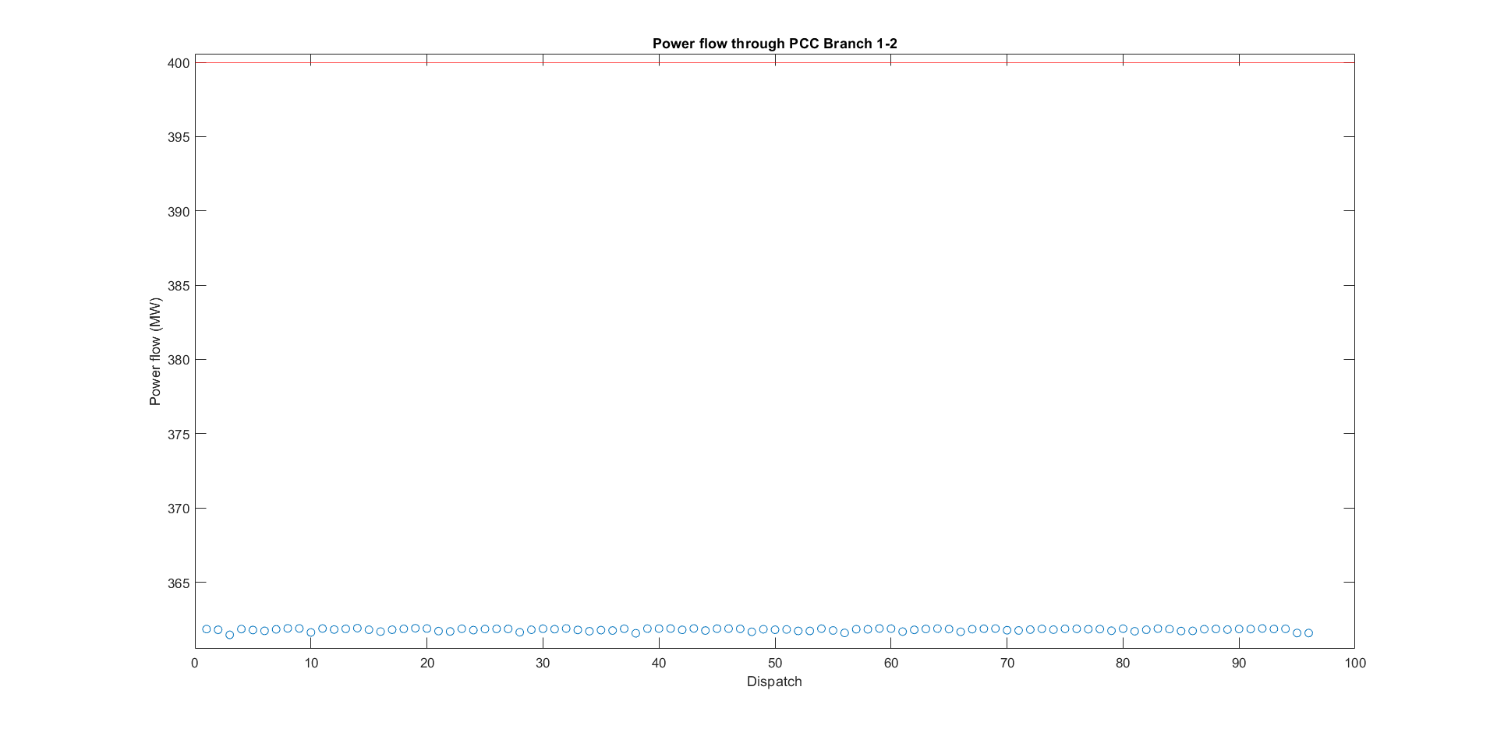
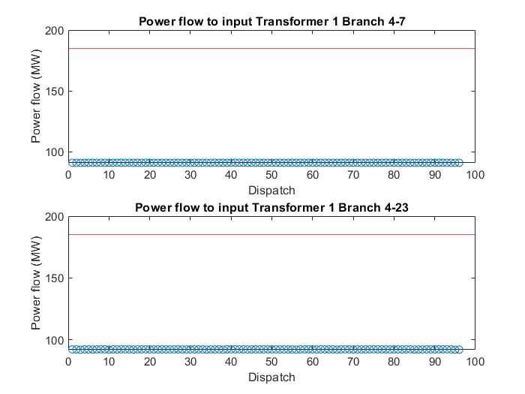
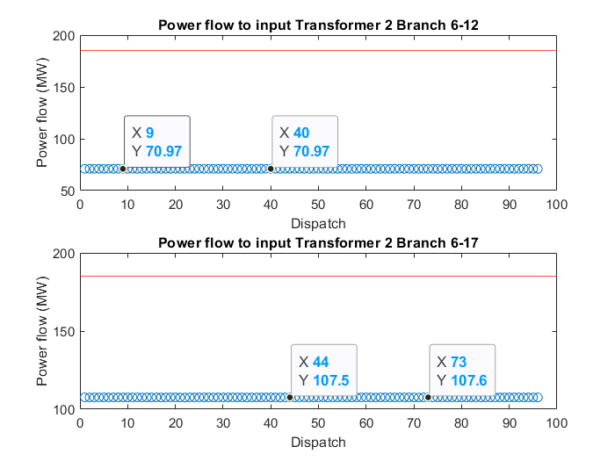
Solar Farm design
Solar farm capacity
Notes:
So, in order to determine the active power generation of the solar farms an analysis is runned using MATLAB, in which the active power generation of the weak components is plotted for every dispatch with the power limit given by the red line. As can be seen in the plots, the branches of the transformers and the transformers can handle enough power. However, the cable at the PCC has a power limit of 400MW, while being loaded with 360 MW, so only 40 MW can be added. From this analysis we came to the conclusion that we will design the solar farm with a power capacity of 12 MW, which will overload the branch limit, in order to perform a research in which we'll test how we could solve this.

Slide 15
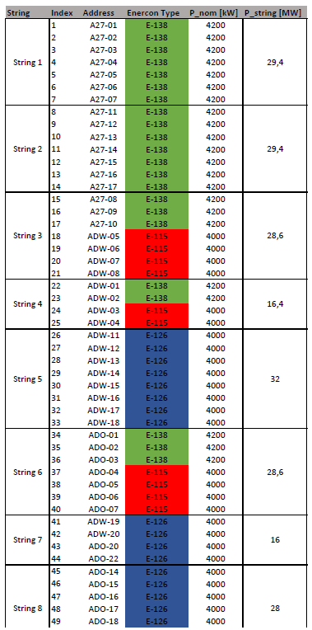
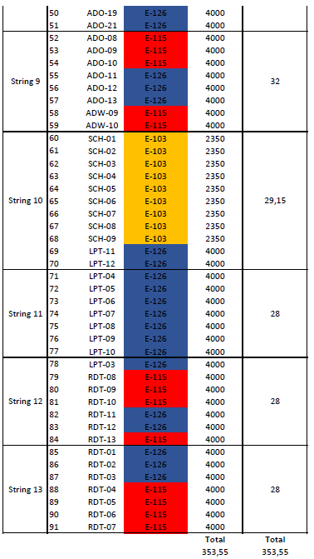
WTG overview
Notes:
So, in order to determine the active power generation of the solar farms an analysis is runned using MATLAB, in which the active power generation of the weak components is plotted for every dispatch with the power limit given by the red line. As can be seen in the plots, the branches of the transformers and the transformers can handle enough power. However, the cable at the PCC has a power limit of 400MW, while being loaded with 360 MW, so only 40 MW can be added. From this analysis we came to the conclusion that we will design the solar farm with a power capacity of 12 MW, which will overload the branch limit, in order to perform a research in which we'll test how we could solve this.

Slide 16
Deliverables
Solar farm design
Behavior analysis for (extreme) loading demands:
Analysis using 2-D and 3-D relation between parameters plots
Vector with requested parameters for optimization subgroup
Proof of concept: Visualization diagram
Notes:
Since the case study used involves the combination of a wind-and solar farm, the first deliverable is a solar farm that can be added to the wind park. The solar farm should not cause violations in the system during any requested setpoints. Therefore, the system must converge for power flows during which normal load demands are requested.
Subsequently, in a stepwise manner, the operating conditions will be tested. The test analysis will yield 2-D plots for the voltage magnitude, angle for and active, reactive, injective power for all nodes. A final 3-D plot is made for the relation between total system losses, load demand and voltage profile.
In order for the optimization scheme to calculate and predict feasible search spaces, the test models are of importance to calculate actual physical constraints of the system and losses under extreme conditions. With this, the effect on system losses by the optimal setpoint can be compared to the effect of regular setpoints. This information is sent in the form of a vector to the optimization subgroup.
To show that the model is able to update the system configuration for given dispatches and setpoints, a visualizable diagram will be designed. This will show the Power Flow through all the branches in the transmission after every update of information.

Slide 17
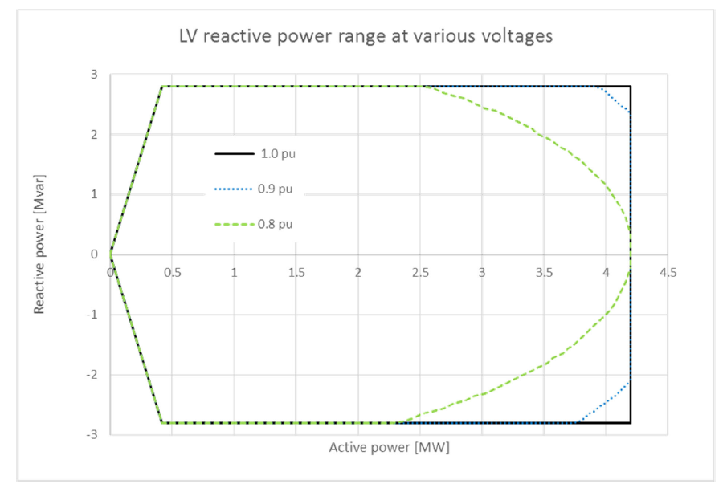
Course ahead
Modeling of WTGs strings
on string level
Test models for varying wind
speeds and irradiance
Distribution | Wind | Solar
Beta-Cauchy | Off | On
Weibull | On | Off
Weibull & Beta-Cauchy | On | On
Notes:
Now, the goal is to have an accurate model for which the behavior is known for all operating conditions.
Therefore, the information of the transmission system is improved by processing the losses in the strings. Additionally, a solution is found to model the non-ideal capability curves of the Wind Turbine Generators.
Next to the improvement of the model, test model conditions are changed stepwise to more extreme conditions. With the use of a probabilistic distribution, the testing is based on realistic conditions.
Finally, with both accurate model and behaviour analysis, the modeling of power flow will prove to be accurate for the power or voltage control at the Point of Common Coupling.

